Slide 1
SMA & HULL TACTICAL Week 7

Slide 2
Today’s Outline
Handling Outliers: Winsorize Method
Preprocessing In-Sample & Out-Sample Data
Model Selection: Regression
Model Selection: Deep Learning
Conclusion
Notes:
Main point of this week: feature filtering

Slide 3
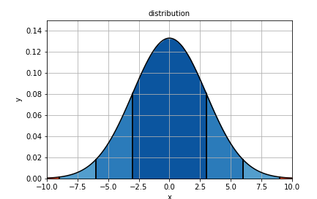
Handling Outliers

Slide 4
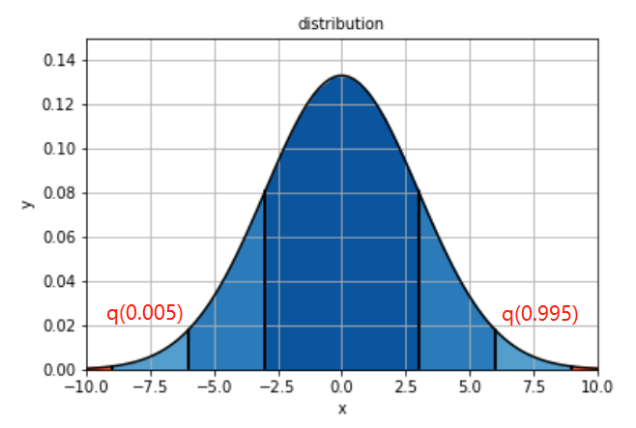
Handling Outliers: Winsorizing Method
Censors the data rather than excluding it.
Accomplished by identifying outliers in the data based on quartiles and replaces them with the quartile value
Used in-sample to generate winsorized dataset and then apply it to the test set (example on the next slide)
Standardization & Scaling was also performed in this way: fitting to in-sample data and then using the calculated means / var on the out-of-sample data Scaling
Notes:
Sentiment dispersion

Slide 5
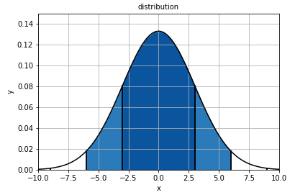
Preprocessing In-Sample & Out-Sample Data
Notes:
Sentient volumn

Slide 6
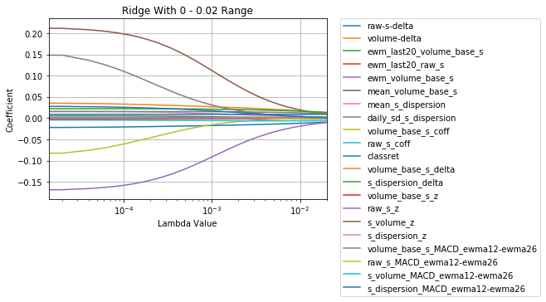
Week 6 Refresher: Ridge Regression
Ridge
Last 5 decayed below 1e-5:
raw_s_MACD
s_dispersion_delta
volume_base_s_delta
ewm_volume_base_s
mean_volume_base_s

Slide 7
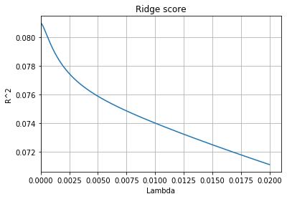
Week 6 Refresher: Ridge Regression
Max Score: 0.081
Notes:
Accuracy score very low, indicating linear regression not effective in prediction.
However does not affect usefulness of single factor. As long as noise filtered out, factor still useful with other models.

Slide 8
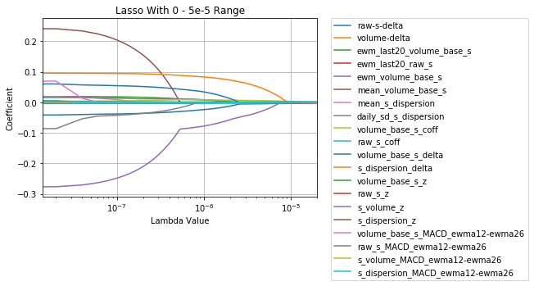
Week 6 Refresher: Lasso Regression
Lasso
Last 5 decayed to 0:
volume_base_s_z
raw_s_z
s_dispersion_z
raw_s_coff
ewm_last20_raw_s

Slide 9
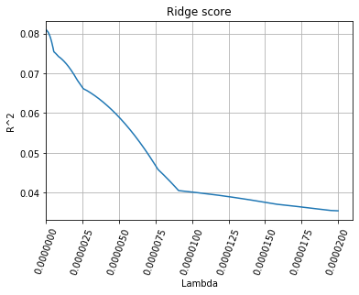
Week 6 Refresher: Ridge Regression
Max Score: 0.081

Slide 10
Elastic Net Model
Top 5 Performing Scores:
Top 5 Performing Scores:
Cross Validation with Standardized Data
10-fold
Alpha: 0 – 0.005
l1-ratio: 0-1
Top 5 Mean Test Scores:
Notes:
Mean sentient dispersion, downward trend eliminated

Slide 11
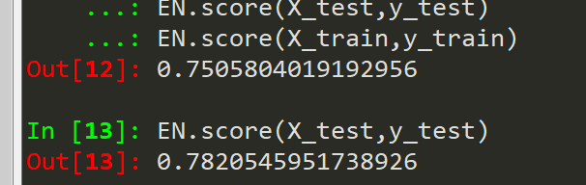
Elastic Net Model
Top Performing Parameter Set:
Test and Training Score with optimal parameter
- Test data standardized on basis of training data
Notes:
Mean sentient dispersion, downward trend eliminated

Slide 12
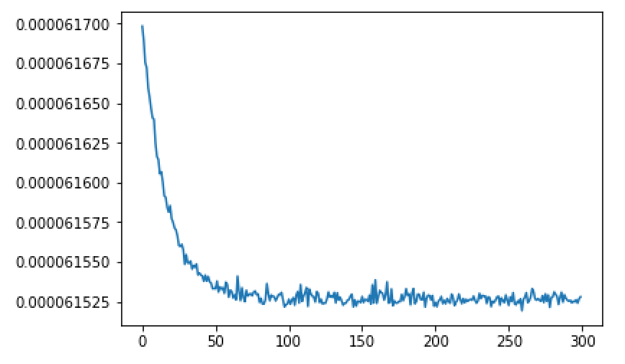
Deep Learning Model
4-layer DNN model with PCA
Train Set: data until 09/2017
Test Set: data from 10/2017 to 12/2017
Accuracy score:
Loss Function Decay
In-sample | Out-sample
0.3% | 0%
Notes:
Mean sentient dispersion, downward trend eliminated

Slide 13
Thank you!
Notes:
PCA is orthorgonal transformation of each factor

